Slide 1
Online Data Processing:- Weather
Team Members:-
Daishik Ghatalia
Sai Pavan Malisetty
Sai Krishna Karthik Chillara
Harpreet Singh
Yuanjun Jin

Slide 2



RegEx
Regular Expressions or Regex (in short) in Java is an API for defining String patterns that can be used for searching, manipulating, and editing a string in Java.
Email validation and passwords are a few areas of strings where Regex is widely used to define the constraints. Regular Expressions are provided under java.util.regex package.
This consists of 3 classes and 1 interface.

Slide 3
TST
The TST class represents an symbol table of key-value pairs, with string keys and generic values. It supports the usual put, get, contains, delete, size, and is-empty methods.
It also provides character-based methods for finding the string in the symbol table that is the longest prefix of a given prefix, finding all strings in the symbol table that start with a given prefix, and finding all strings in the symbol table that match a given pattern.
A symbol table implements the associative array abstraction: when associating a value with a key that is already in the symbol table, the convention is to replace the old value with the new value.
Unlike Map, this class uses the convention that values cannot be null—setting the value associated with a key to null is equivalent to deleting the key from the symbol table.

Slide 4


StdDraw
The StdDraw class provides a basic capability for creating drawings with your programs.
It uses a simple graphics model that allows you to create drawings consisting of points, lines, squares, circles, and other geometric shapes in a window on your computer and to save the drawings to a file.
Standard drawing also includes facilities for text, color, pictures, and animation, along with user interaction via the keyboard and mouse.

Slide 5
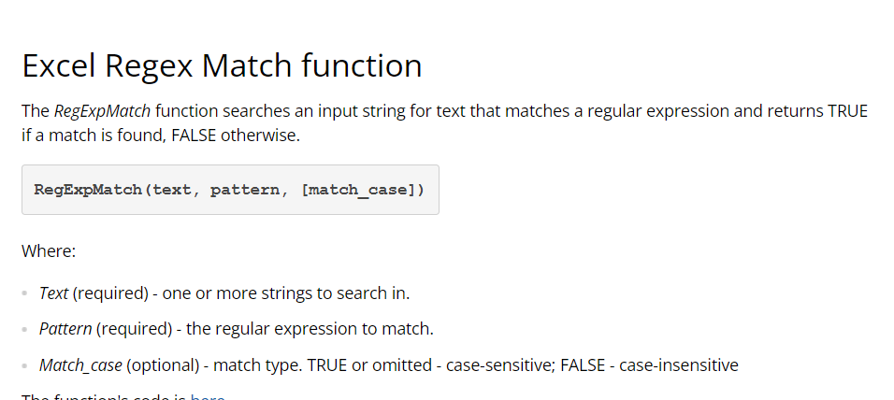

Slide 6
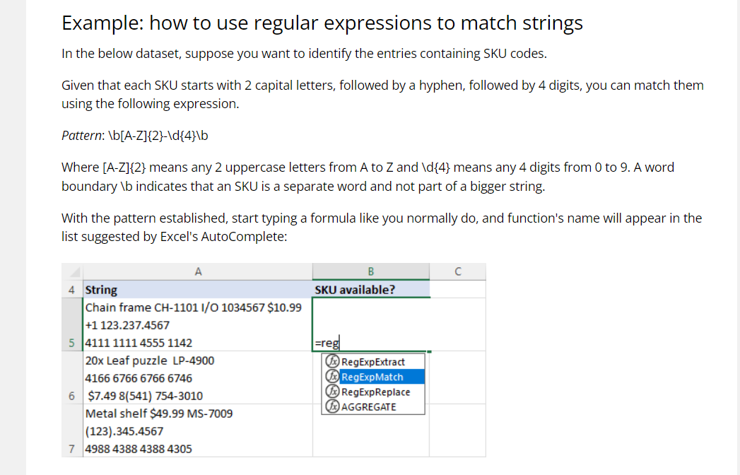

Slide 7
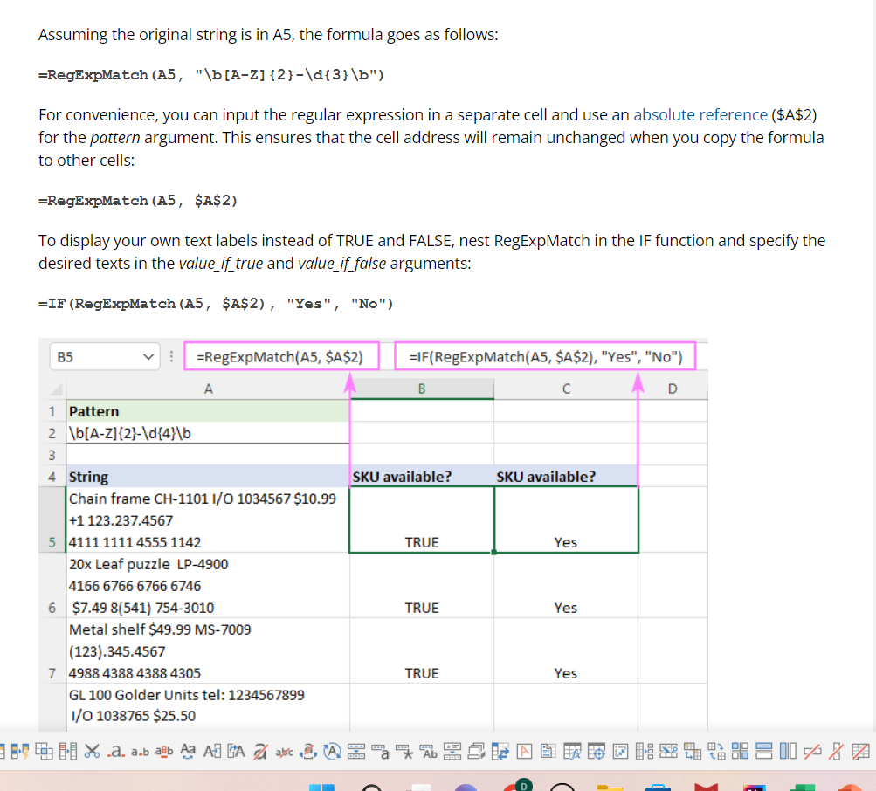

Slide 8
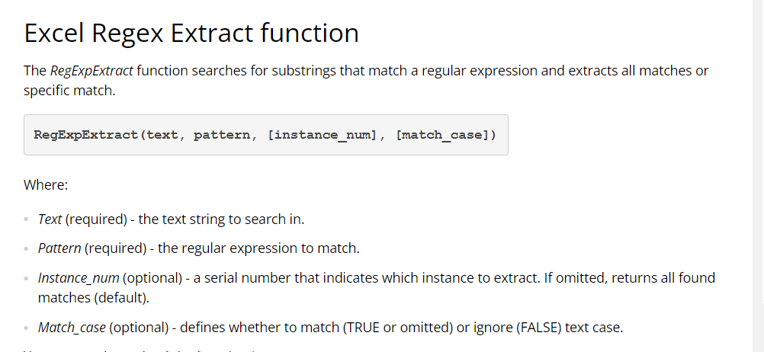

Slide 9
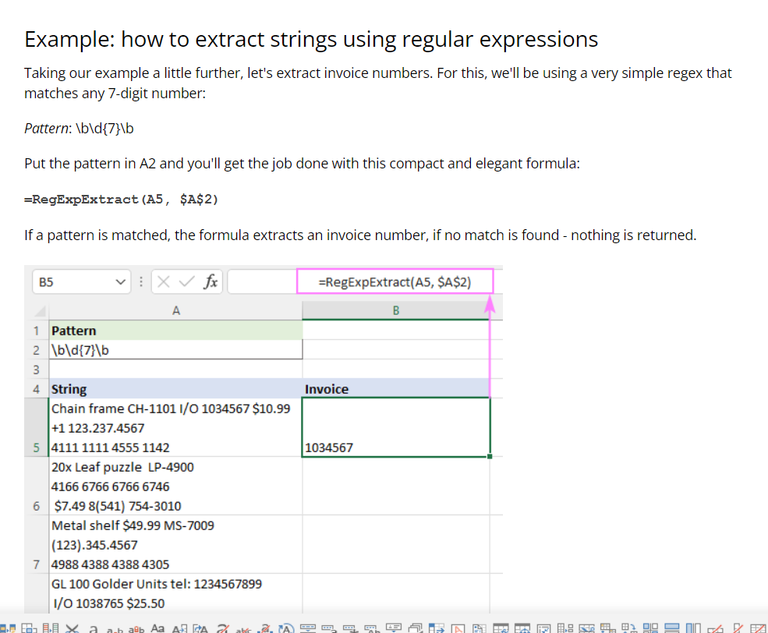

Slide 10
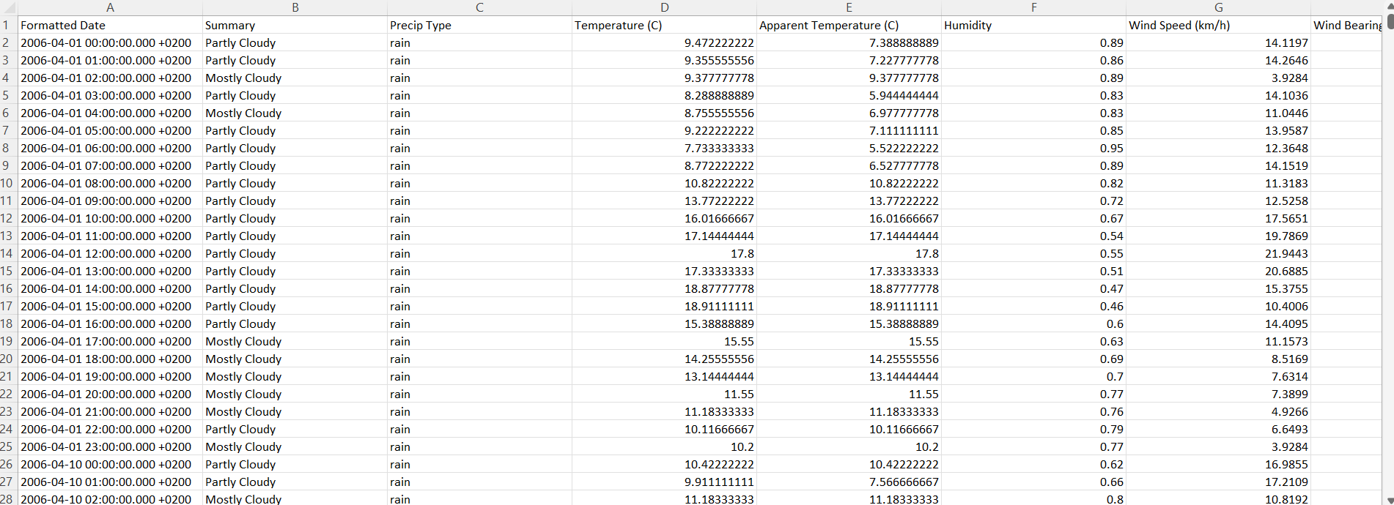

Slide 11
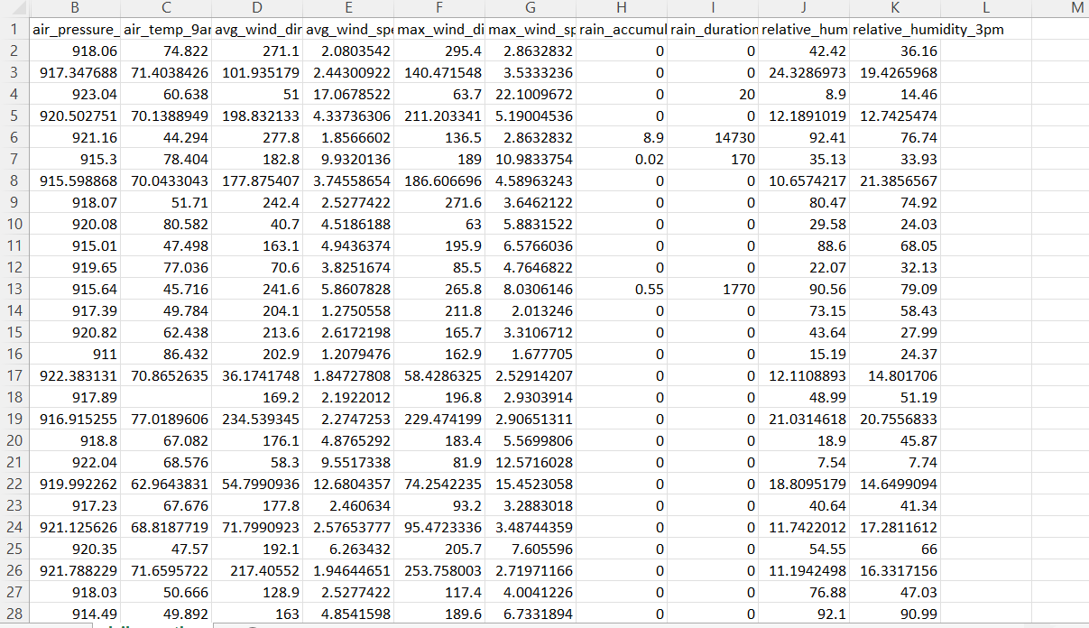

Slide 12
Thank You

